Slide 1
PIXEL-TO-PLATE
Deep Learning Based Recipe Discovery and Recommendation

Slide 2
Radhika
Prit
Pav Bhaji
Indo chinese
*
*
Anurima
Sayandip
Pizza
Chingri Malai Curry
*
Sai
*
Chicken dum biryani
*

Slide 3
INTRODUCTION
OBJECTIVE
PLAN
ALGORITHMS
Creating a cutting-edge recipe recommendation system that
accepts images of raw materials as input and provides recipes and additional requirements at as output through visual analysis
Image Processing – Feature Extraction and Classification
Text Analytics – Recipe Data Processing
Recommender System – Link Image with text to produce a list of recommendations
Deep Learning (CNN and Classifier)
Natural Language Processing

Slide 4

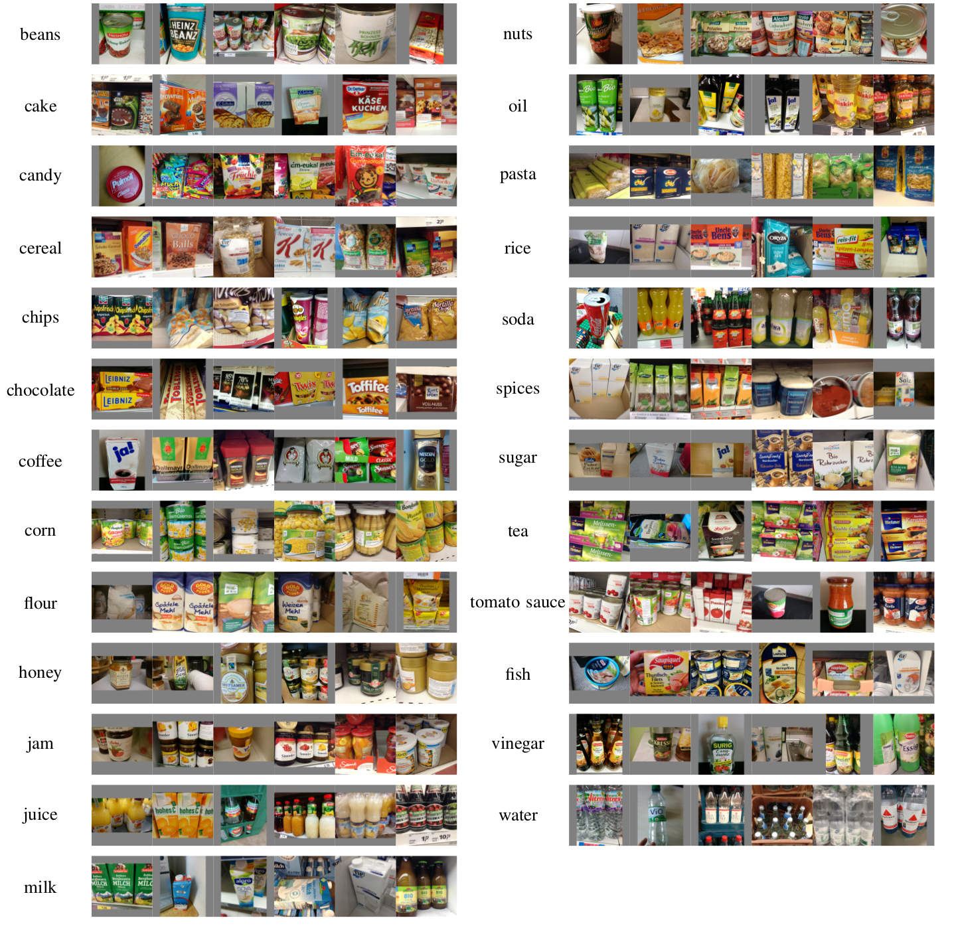
Freiburg Groceries Dataset:
25 food classes, 4947 images
Baseline classifier accuracy with CaffeNet: 78.9%
Dataset, trained model, code, and data splits publicly available for research and development

Slide 5

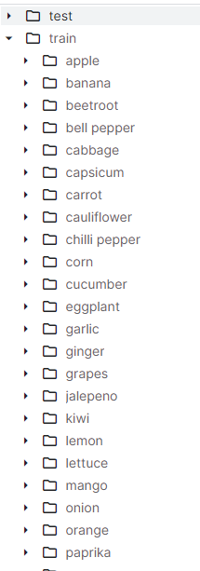
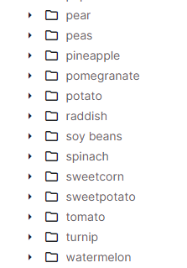
/kritikseth-fruit-and-vegetable-image-recognition
Comprehensive Image Recognition Dataset: Fruits and Vegetables
Three partitions:
Train (100 images per class)
Test (10 images per class)
Validation (10 images per class)
Includes diverse fruit and vegetable types
Images scraped from Bing Image Search to represent varied condition

Slide 6
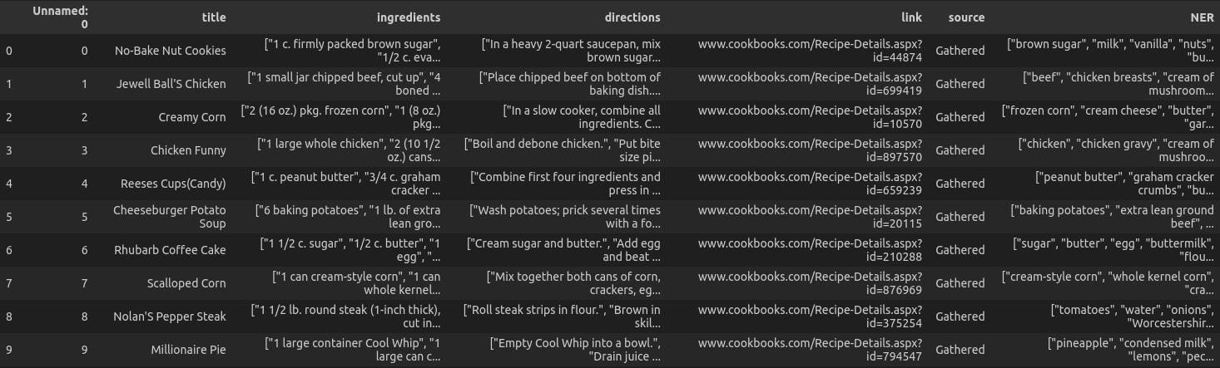
RecipeNLG: A Cooking Recipes Dataset for Semi-Structured Text Generation
The ‘Recipes’ dataset contains information about various recipes. The following features are present which can be further engineered:-
Title - Gives us information about the names of various available recipes.
Ingredients - Contains information about the amount of ingredients required for the particular recipe.
Directions - Includes a brief step by step process about the preparation.
Named Entity Recognition - Provides the contents of the recipe.
The purpose of this dataset in our project is to correlate from the available ingredients and predict all possible recipes.

Slide 7
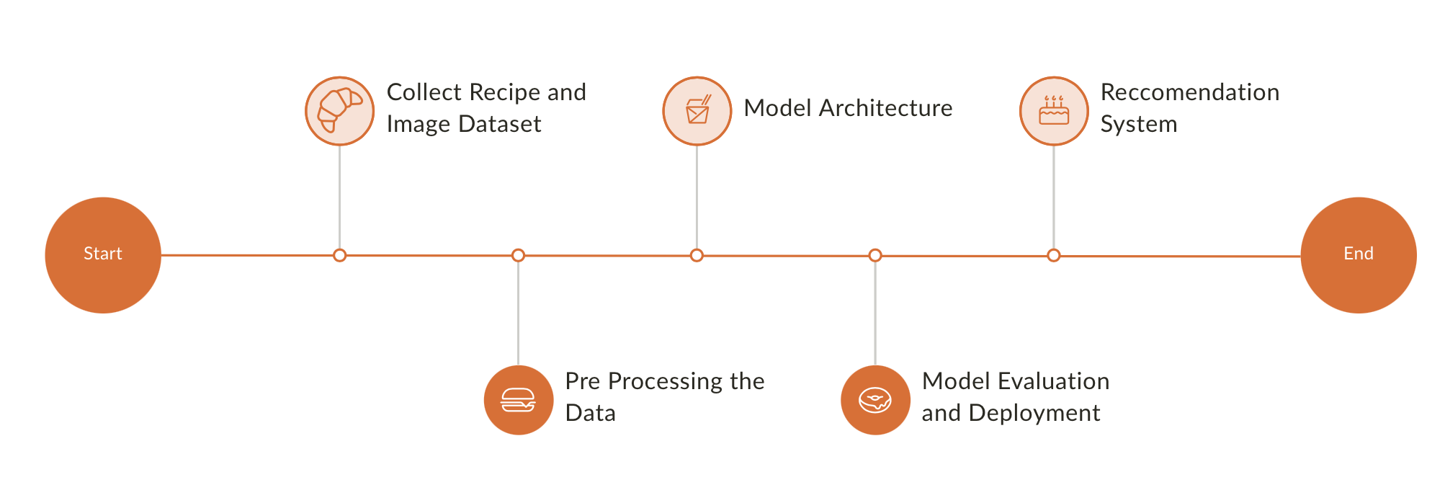
Process Flow

Slide 8
Impact
Improved UX
Deliver a personalized and aesthetically pleasing culinary journey for users.
Sustainability
Tackle the global concern of food waste by advocating recipes that match available ingredients.
Learning Hub
Explore diverse ingredients, cooking methods, and a world of culinary possibilities
Healthier Eating
Embed nutritional insights to support healthier recipe selections aligned with user preferences.

Slide 9


THANK YOU!

